Slide 1
Seminar 5
06th May 2016, Tran Viet Cuong

Slide 2
2 weeks
Finding MCU
Finding ECG sensor (Dry contact)
EMG signal

Slide 3
MCU
For wearable device, MCU needs:
Low-Power
Fast enough to operate standalone system
How to know MCU whether is enough to operate:
ROM
RAM
CPU

Slide 4
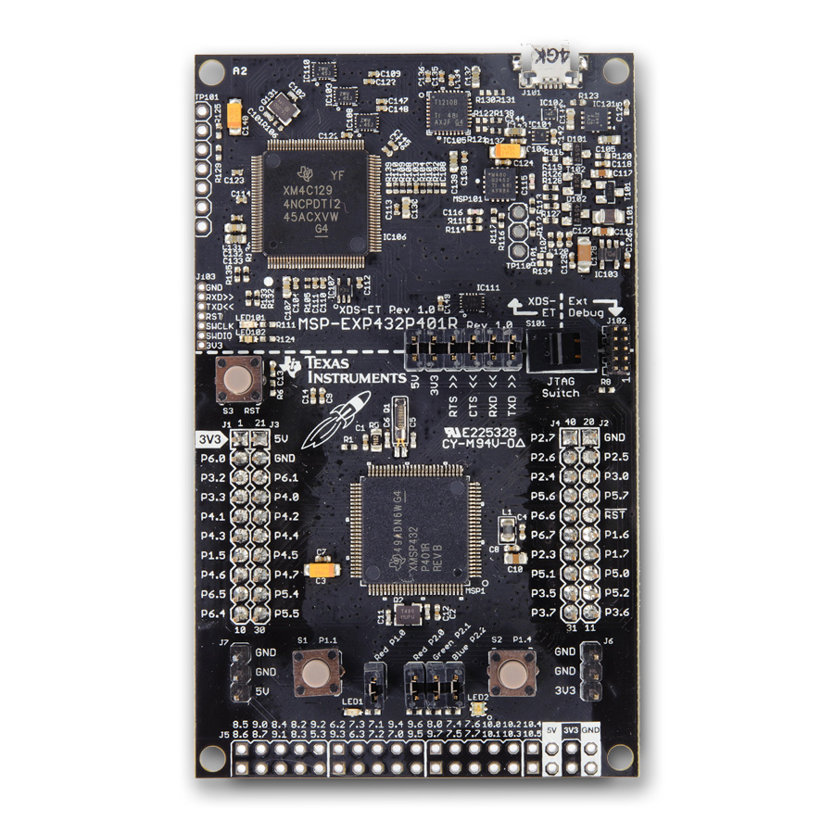
MCU
MSP432P401R LaunchPad:
Ultra Low Power
48MHz
32-bit ARM Cortex M4F with Floating Point Unit and DSP acceleration
256KB Flash
64KB RAM
24ch 12-bit ADC
Comparator
4 16-bit, and 2 32-bit Timers
Up to 4 I2C, 8 SPI, 4 UART

Slide 5
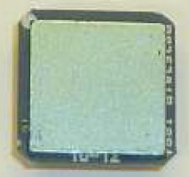
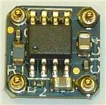
ECG sensor (Dry contact)
PS25205B (EPIC sensor)
Low current 1.4mA
Dry-contact capacitive coupling
Operates with bipolar power supply from ±2.4V to ±5.5V

Slide 6
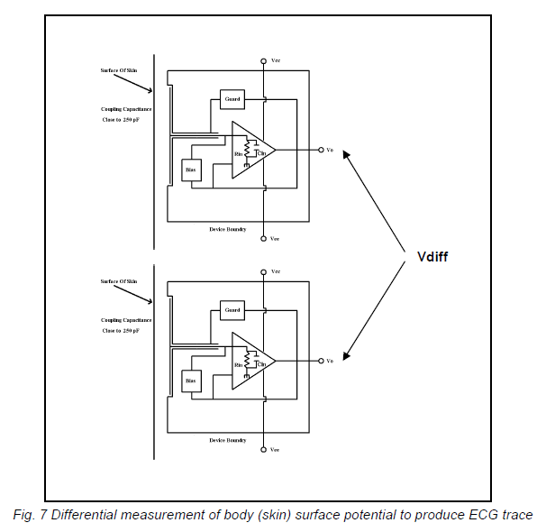
ECG sensor

Slide 7
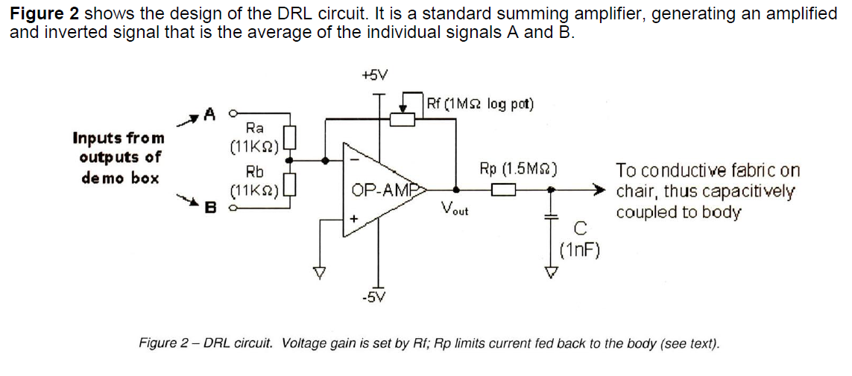
ECG sensor

Slide 8
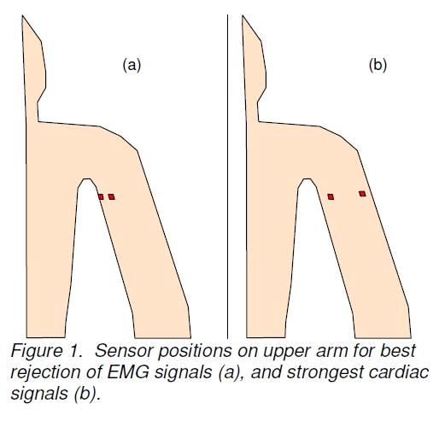
ECG sensor

Slide 9
EMG signal
EMG signal property:
Non-stationary
Nonlinear
Complexity
Large variation
To make a system based on EMG first we need to extract the features of the acquired EMG signal based on which it can be further classified for purpose (ex. Various hand movements).
Common features for classifying EMG signal: mean absolute value, varience, standard deviation, maximum value, zero crossings, …

Slide 10
EMG signal
EMG signal processing:
Wavelet analysis
Autoregressive model
Artificial intelligence
Higher-order statistics
others

Slide 11
EMG signal
Artificial intelligence (based on Neural Networks)
Useful for real-time application (EMG signal recording and analysis)
EMG signal features are first extracted through Fourier analysis and clustered using fuzzy c-means algorithm (method of clustering which allows data to belong to 2 or more clusters)
Fuzzy logic systems are advantageous in biomedical signal processing and classification

Slide 12
Next 2 weeks
Fuzzy logic system
Try to extract EMG signal features

Slide 13
Thank you!!!

Slide 14
Question??

Slide 15


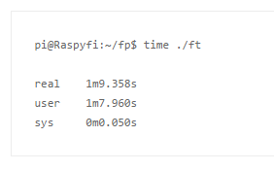
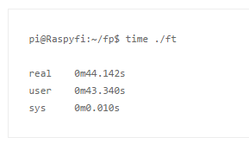
MCU
Run a floating point multiplication 1,000,000,000 times. CPU performance, 14 Mflops (7MHz)
Not need memory access all the time, this should need less memory access then the performance less than 25MFops

